Slide 1
Commissioning and Operating a Direct Metal Laser Melting (DMLM) 3D Printer
Riley Shepard, Erik Leon, Sichao Jiang

Slide 2
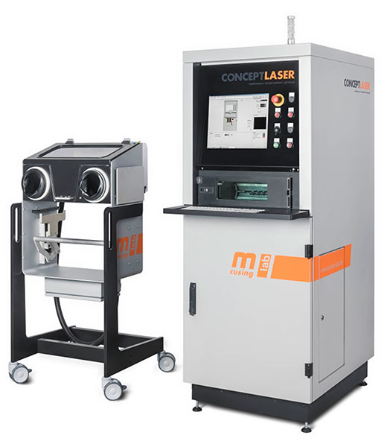
Project Description
Printer: Concept Laser MLab Cusing 100R
Final Commissioning
Individual Design Projects
Service- Please contact us if interested
Impact: Expand NAU's manufacturing capabilities
Mentors: Mike Downey, Justin Sokel
Client: IDEA Lab and ME Department- Dr. Ciocanel
Figure 1: Concept Laser MLab cusing 100 R
Sichao, 1

Slide 3
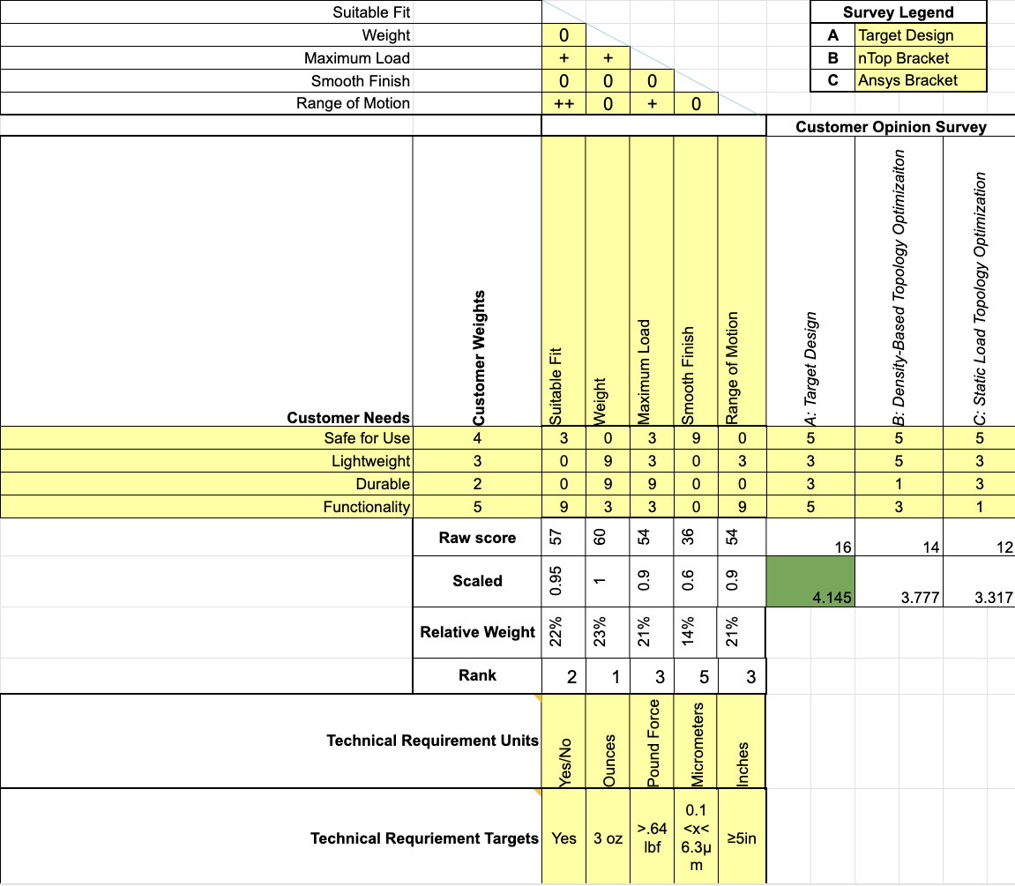
Design Requirements- Erik
Engineering Requirements:
Weight: <3oz
Max Load: >.64lbf
Surface Finish: 0.1 - 6.3μm
Reach: ≥5in
Customer Requirements:
Safe for Use
Lightweight
Durable
Functional
Table 1: Excavator Stick QFD
Erik, 2
Notes:
Show your updated QFD with as many rooms filled in as possible. Give the class a top-level description of each CR/ER, discuss ER target values and units, and give us a final discussion on how ERs and CRs relate to each other

Slide 4
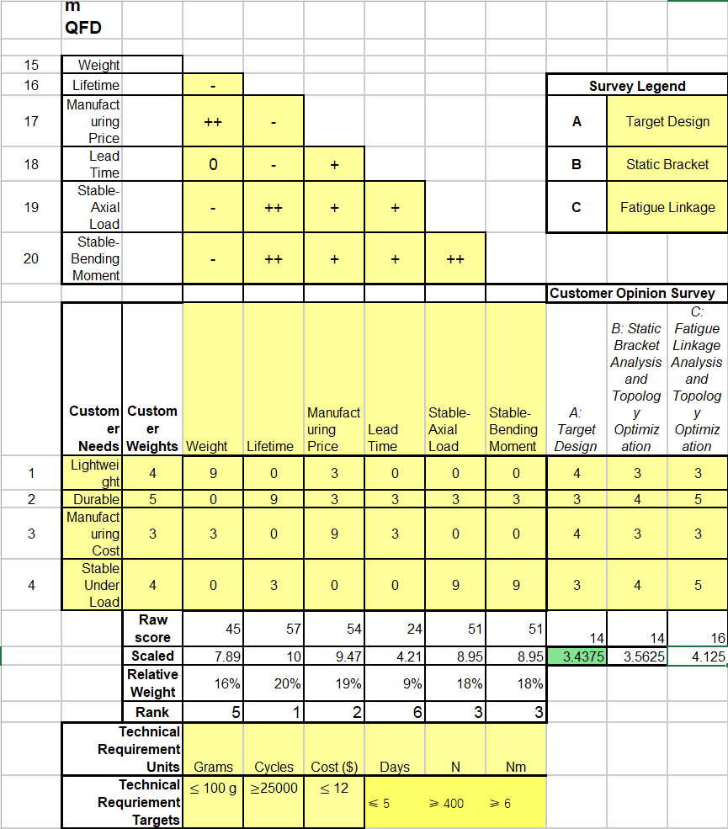
Design Requirements- Sichao
ER
Weight: ≤ 100 g
Lifetime: ≥ 25,000 cycles
Manufacturing Price: ≤ $12
Lead Time: ≤ 5 days
Stable Axial Load: ≥ 400 N
Stable Bending Moment: ≥ 6 Nm
CR
Lightweight
Durable
Low Manufacturing Cost
Stable Under Load
Table 2: Steering Knuckle QFD
Sichao, 3
Notes:
Show your updated QFD with as many rooms filled in as possible. Give the class a top-level description of each CR/ER, discuss ER target values and units, and give us a final discussion on how ERs and CRs relate to each other

Slide 5
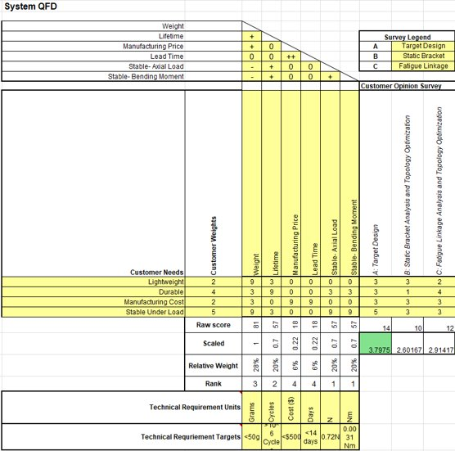
Design Requirements- Riley
Engineering Requirements-
Weight: <50g
Lifetime: 1 million cycles
Manufacturing Price: <$500
Lead Time: <14 days
Axial Loading: 0.72N
Bending Moment: 0.0031Nm
Customer Requirements-
Lightweight
Durable
Manufacturing Costs
Stable Under Loading Conditions
Table 3: Hip Bracket QFD
Riley, 4
Notes:
Show your updated QFD with as many rooms filled in as possible. Give the class a top-level description of each CR/ER, discuss ER target values and units, and give us a final discussion on how ERs and CRs relate to each other

Slide 6
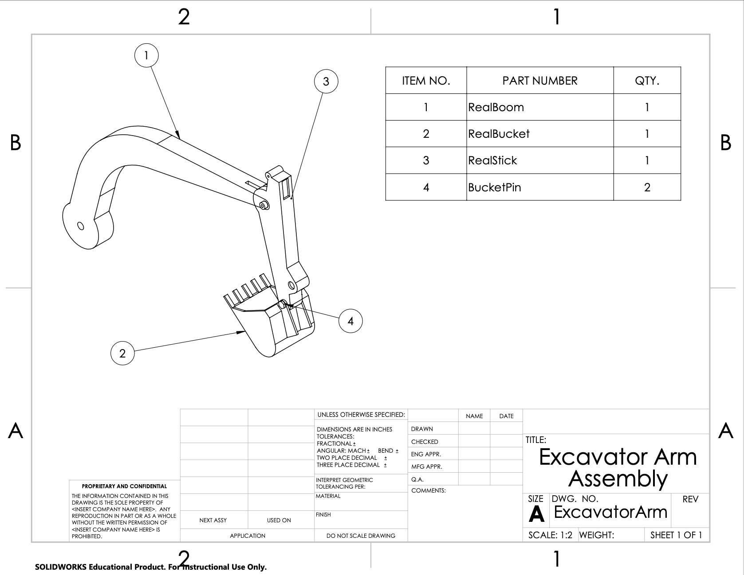
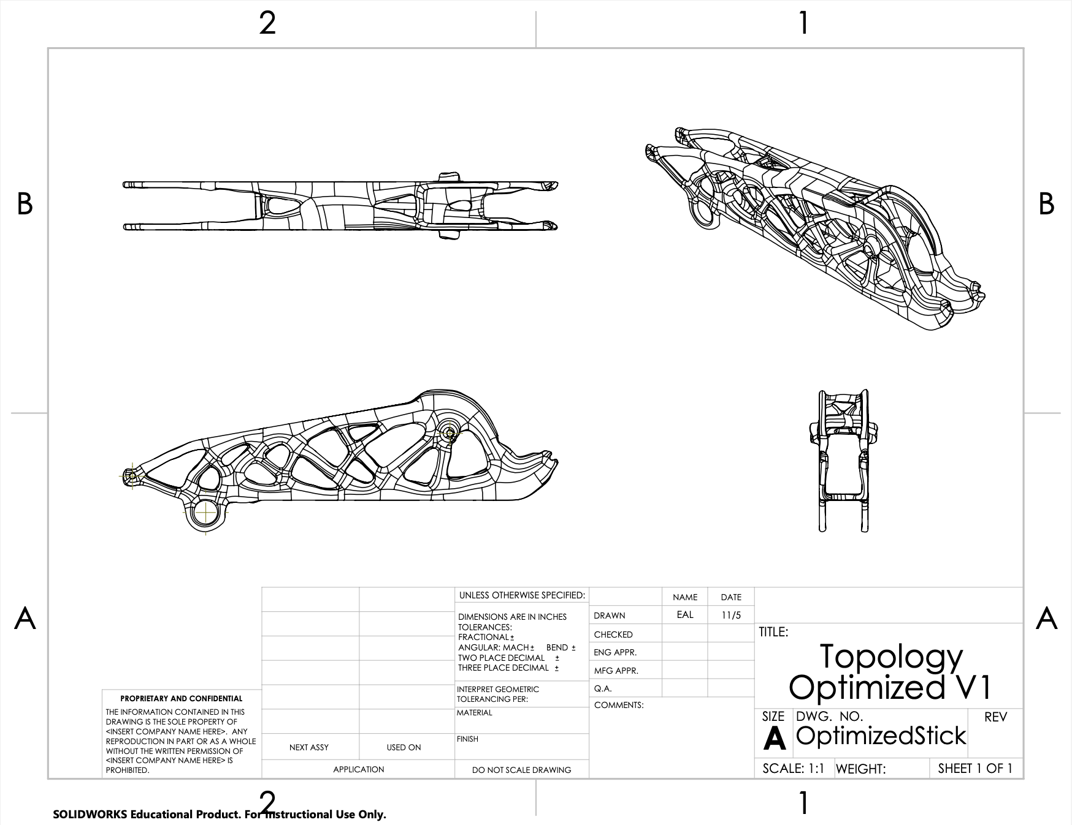
Design Description- Erik
Hollow Stick and Boom with rotating stick inside for movement
Figure 2: Excavator Arm Assembly
Figure 3: Topology Optimized Stick
Erik, 5
Notes:
Provide a high-quality top-level and labeled drawing views of your design identifying major sub- systems. Use Solidworks/Onshape balloons and leader-line notes for this identification. Other engineering graphics needed to convey the design must be included where applicable (example: topo maps, flow charts, etc) • Also provide a bullet list describing how your top-level design functions. • Isolate important/major sub-assemblies and provide labeled drawing views of each identifying major components. Use Solidworks/Onshape balloons and leader-line notes for this identification. • Also provide a bullet list describing how each sub-systems function. • Show any other flow charts, or other diagrams as needed. Such as pipe flow, circuit, wiring, and/or control theories. • Hand out physical copies of any Part/Assembly drawings, flow charts, or other diagrams to the class (one packet per team and instructor) so they can continue to visualize your design as you go through the rest of your slides

Slide 7
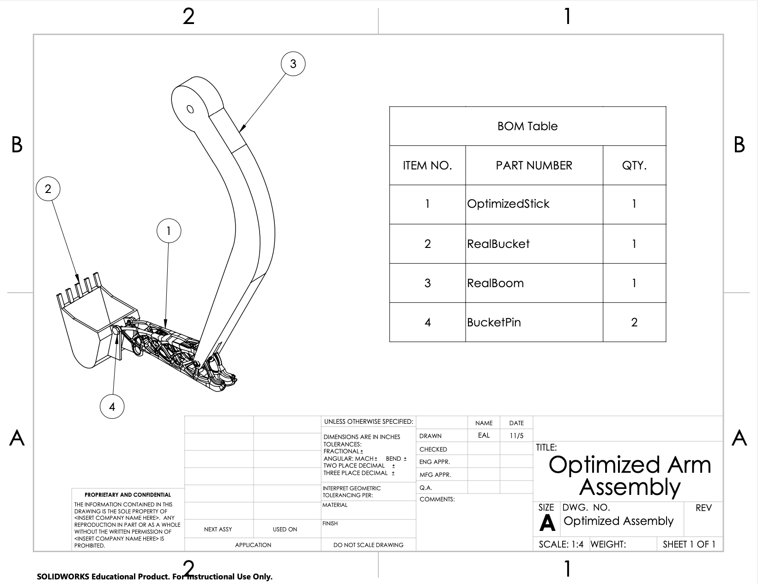
Design Description- Erik
Figure 4: Optimized Arm Assembly
Erik, 6
Notes:
Provide a high-quality top-level and labeled drawing views of your design identifying major sub- systems. Use Solidworks/Onshape balloons and leader-line notes for this identification. Other engineering graphics needed to convey the design must be included where applicable (example: topo maps, flow charts, etc) • Also provide a bullet list describing how your top-level design functions. • Isolate important/major sub-assemblies and provide labeled drawing views of each identifying major components. Use Solidworks/Onshape balloons and leader-line notes for this identification. • Also provide a bullet list describing how each sub-systems function. • Show any other flow charts, or other diagrams as needed. Such as pipe flow, circuit, wiring, and/or control theories. • Hand out physical copies of any Part/Assembly drawings, flow charts, or other diagrams to the class (one packet per team and instructor) so they can continue to visualize your design as you go through the rest of your slides

Slide 8
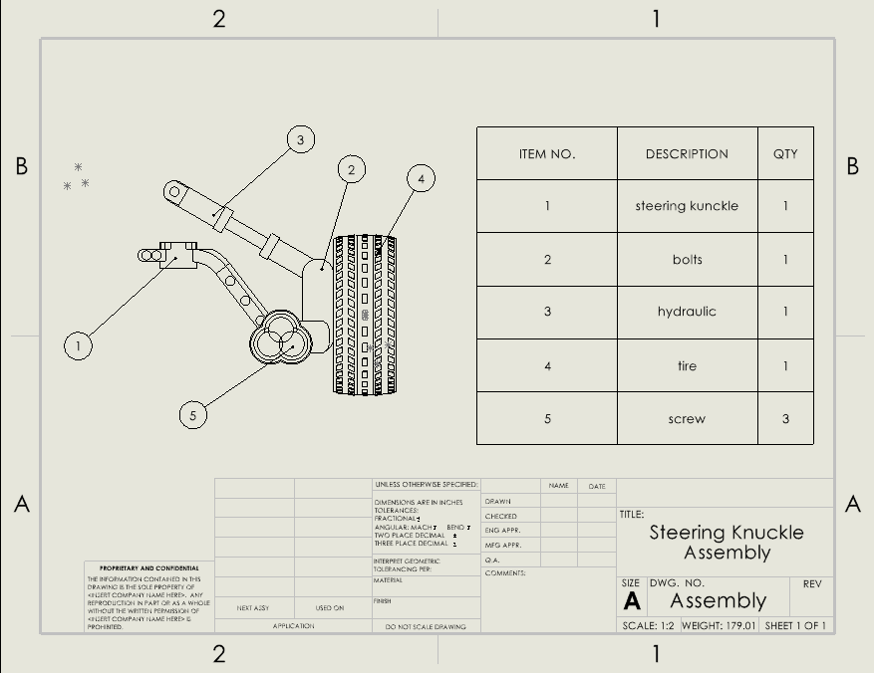
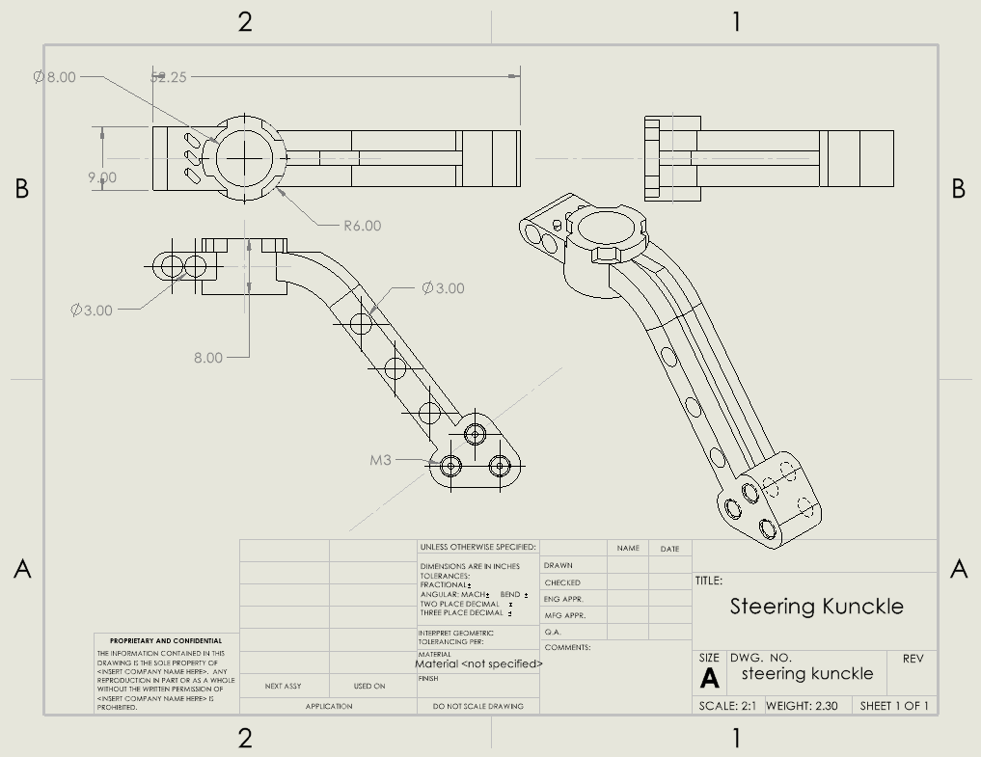
Design Description- Sichao
The steering knuckle connects the wheel hub to the suspension and allows the wheel to turn with the steering system.
Steering Knuckle Assembly and Steering knuckle Design Drawings
Figure 5: Steering Knuckle Assembly
Figure 6: Steering Knuckle
Sichao, 7
Notes:
Provide a high-quality top-level and labeled drawing views of your design identifying major sub- systems. Use Solidworks/Onshape balloons and leader-line notes for this identification. Other engineering graphics needed to convey the design must be included where applicable (example: topo maps, flow charts, etc) • Also provide a bullet list describing how your top-level design functions. • Isolate important/major sub-assemblies and provide labeled drawing views of each identifying major components. Use Solidworks/Onshape balloons and leader-line notes for this identification. • Also provide a bullet list describing how each sub-systems function. • Show any other flow charts, or other diagrams as needed. Such as pipe flow, circuit, wiring, and/or control theories. • Hand out physical copies of any Part/Assembly drawings, flow charts, or other diagrams to the class (one packet per team and instructor) so they can continue to visualize your design as you go through the rest of your slides

Slide 9
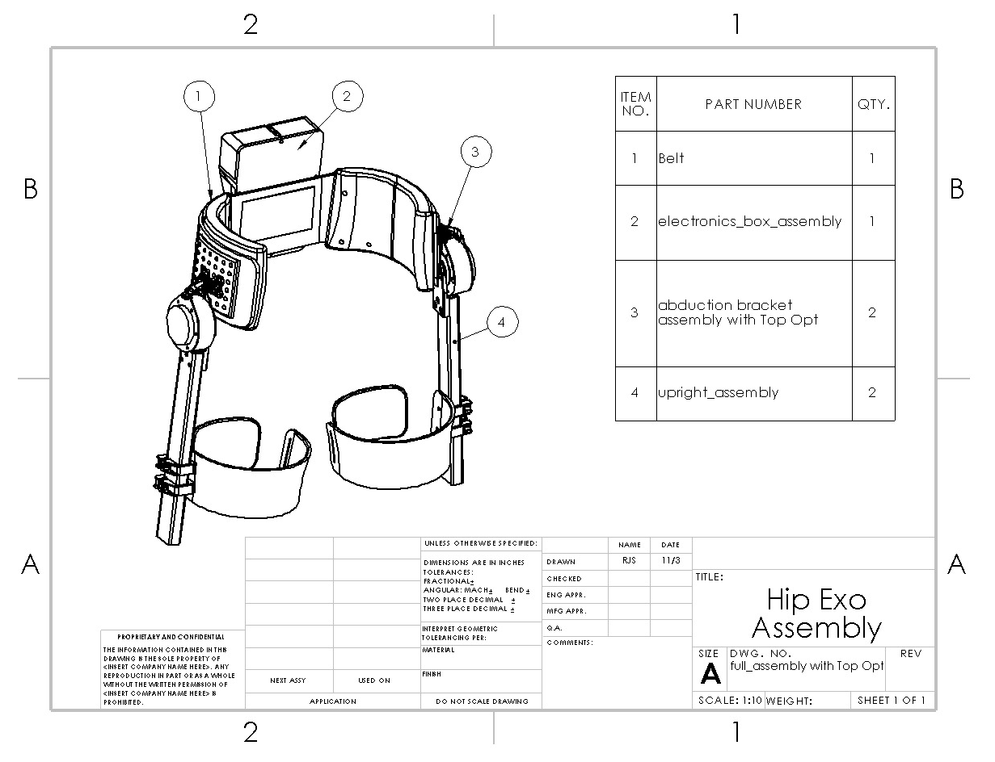
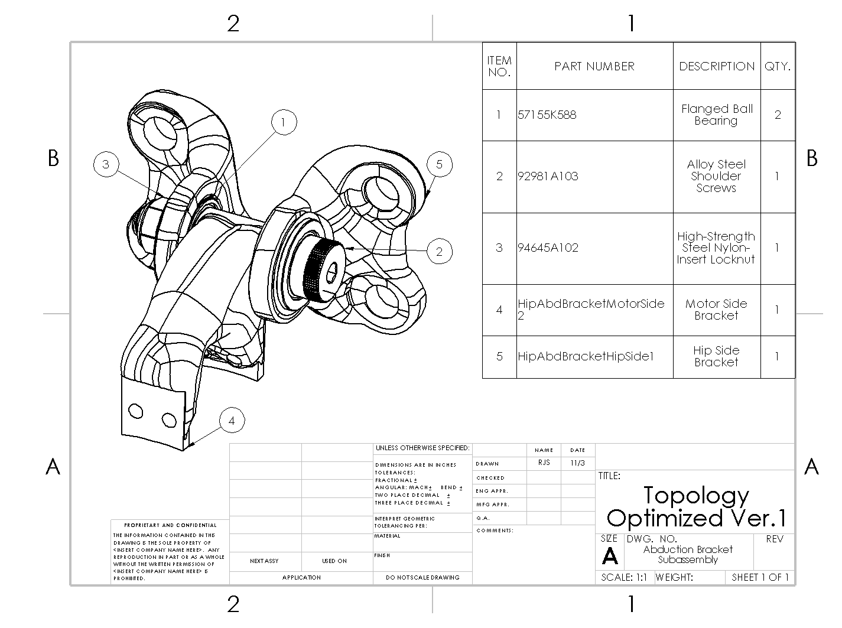
Design Description- Riley
Design Functions
Provide powered assistance at the hip joint
Figure 7: Hip Exo Assembly
Figure 8: Bracket Subassembly
Riley, 8
Notes:
Provide a high-quality top-level and labeled drawing views of your design identifying major sub- systems. Use Solidworks/Onshape balloons and leader-line notes for this identification. Other engineering graphics needed to convey the design must be included where applicable (example: topo maps, flow charts, etc) • Also provide a bullet list describing how your top-level design functions. • Isolate important/major sub-assemblies and provide labeled drawing views of each identifying major components. Use Solidworks/Onshape balloons and leader-line notes for this identification. • Also provide a bullet list describing how each sub-systems function. • Show any other flow charts, or other diagrams as needed. Such as pipe flow, circuit, wiring, and/or control theories. • Hand out physical copies of any Part/Assembly drawings, flow charts, or other diagrams to the class (one packet per team and instructor) so they can continue to visualize your design as you go through the rest of your slides

Slide 10
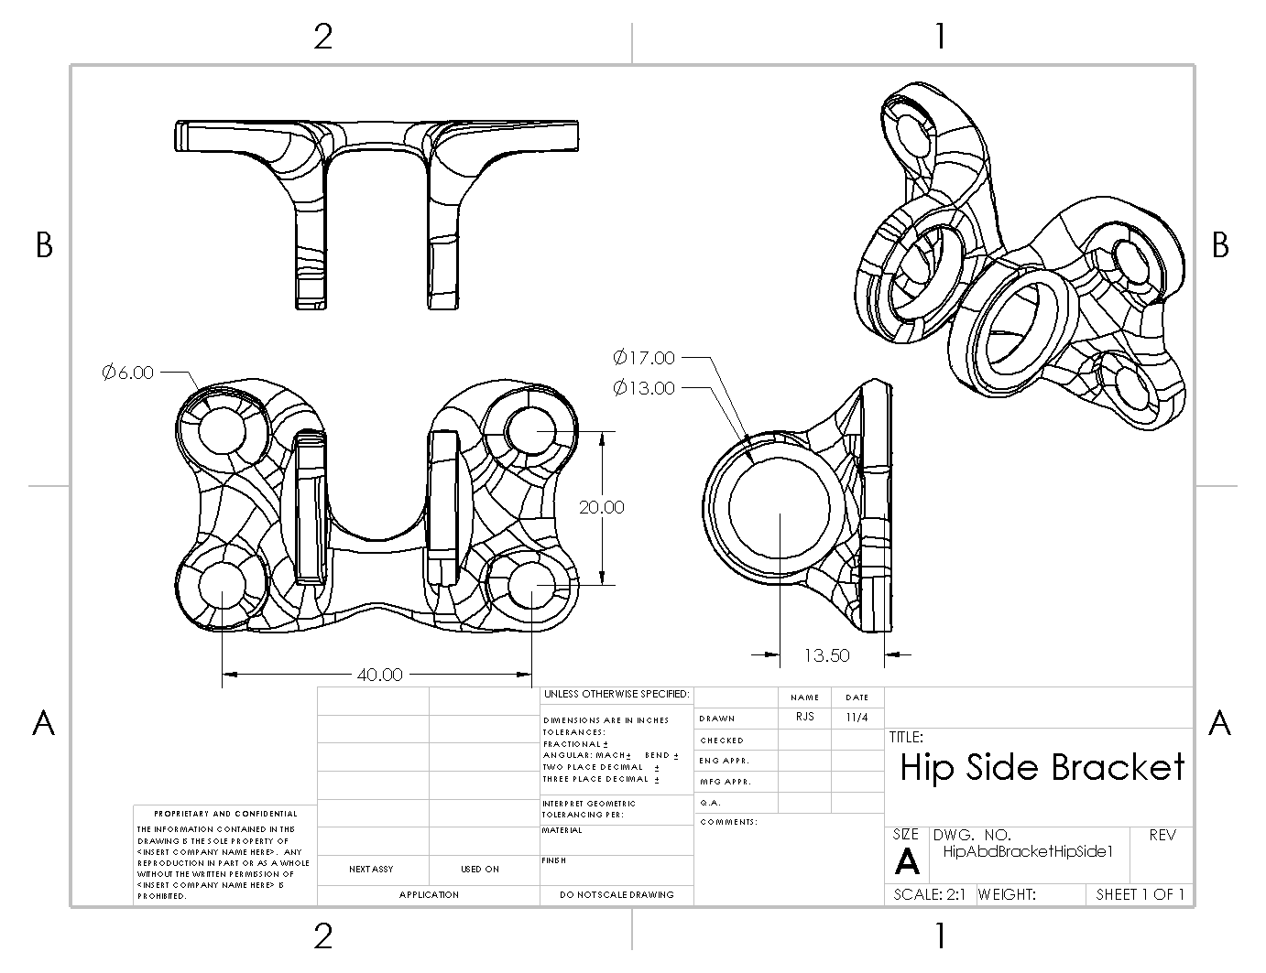
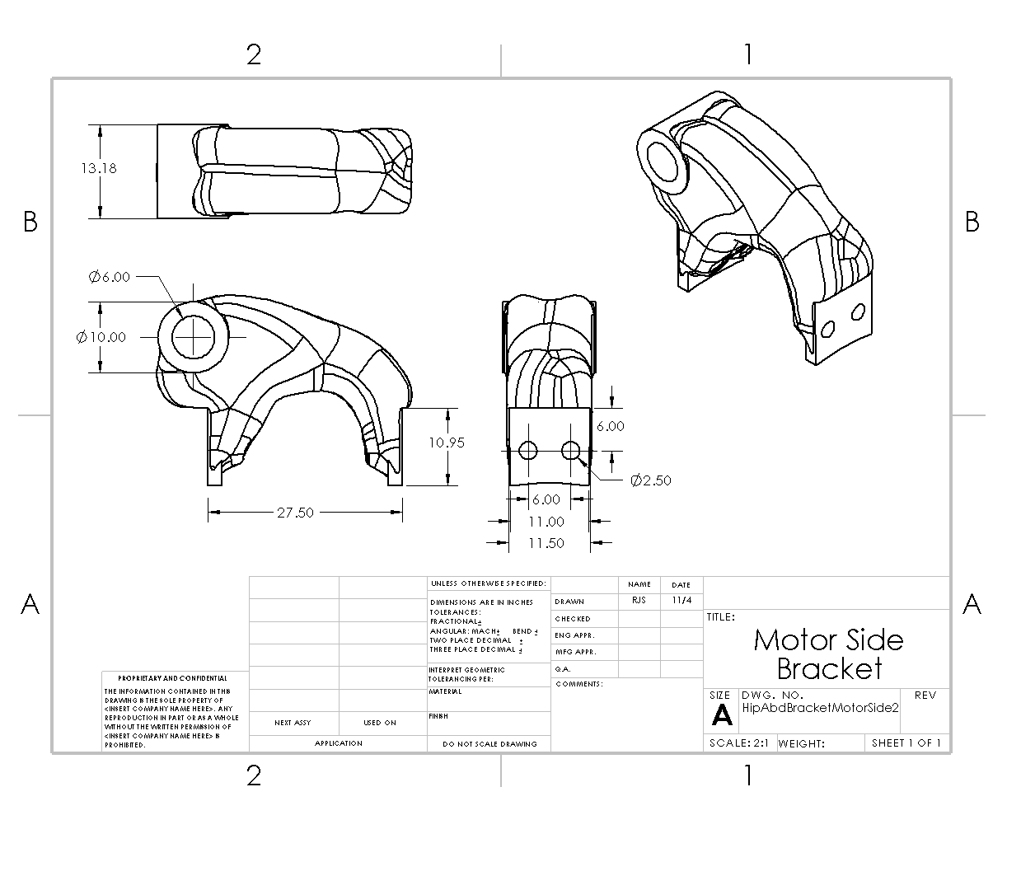
Design Description- Riley
Component Design Functions
Allows hip abduction and adduction DOF
Rigid connection between the hip belt to the motor
Figure 9: Hip Side Bracket
Figure 10: Motor Side Bracket
Riley, 9
Notes:
Provide a high-quality top-level and labeled drawing views of your design identifying major sub- systems. Use Solidworks/Onshape balloons and leader-line notes for this identification. Other engineering graphics needed to convey the design must be included where applicable (example: topo maps, flow charts, etc) • Also provide a bullet list describing how your top-level design functions. • Isolate important/major sub-assemblies and provide labeled drawing views of each identifying major components. Use Solidworks/Onshape balloons and leader-line notes for this identification. • Also provide a bullet list describing how each sub-systems function. • Show any other flow charts, or other diagrams as needed. Such as pipe flow, circuit, wiring, and/or control theories. • Hand out physical copies of any Part/Assembly drawings, flow charts, or other diagrams to the class (one packet per team and instructor) so they can continue to visualize your design as you go through the rest of your slides

Slide 11
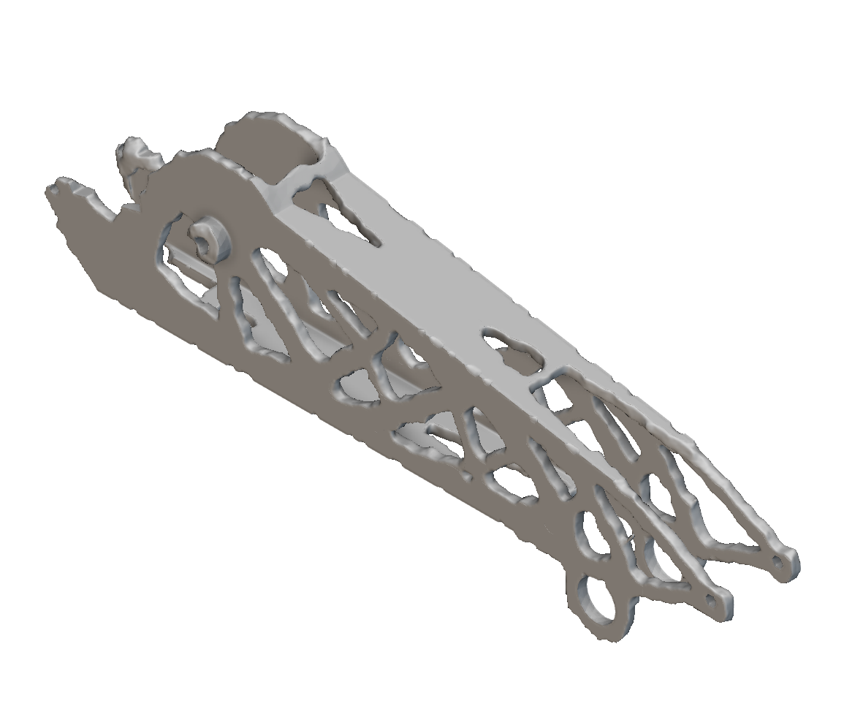
Engineering Calculations- Erik
Applied boundary conditions used in FEA and a volume constraint of .5
Calculated new loads using actual dimensions
Figure 11: nTop Optimized Stick
Erik, 10
Notes:
Update your engineering calculations, analysis tools, etc. Show them, their results, and how they informed your design. Also show part specifications and other quantifiable metrics used to determine selection (for example: you may pick a motor based on power, torque, RPM, etc) • Identify ERs and CRs still yet to be quantified and how you plan to prove that your design will work mathematically before “taking it off of the page”

Slide 12
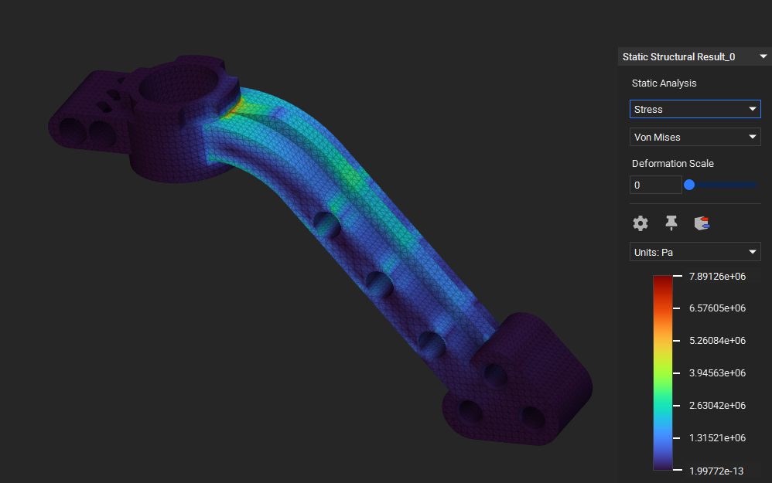
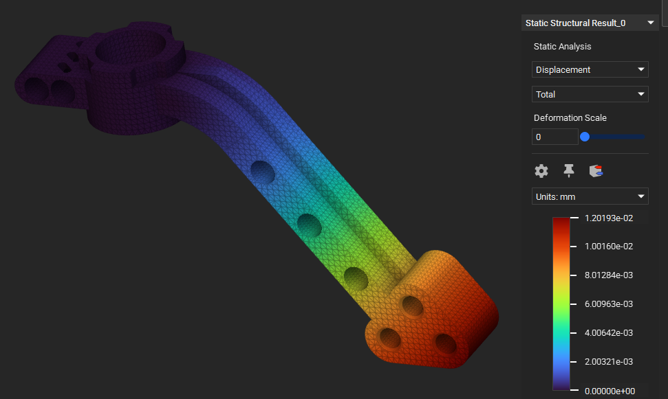
Engineering Calculations- Sichao
Basic Static Finite
Element Analysis
The maximum total displacement is approximately 0.012 mm at the free end, indicating high structural stiffness.
The maximum Von Mises stress is about 7.9 MPa, concentrated near the fixed joint region and well within safe limits.
Figure 12: Steering Knuckle Static FEA
Figure 13: Steering Knuckle Displacement FEA
Sichao, 11
Notes:
Update your engineering calculations, analysis tools, etc. Show them, their results, and how they informed your design. Also show part specifications and other quantifiable metrics used to determine selection (for example: you may pick a motor based on power, torque, RPM, etc) • Identify ERs and CRs still yet to be quantified and how you plan to prove that your design will work mathematically before “taking it off of the page”

Slide 13
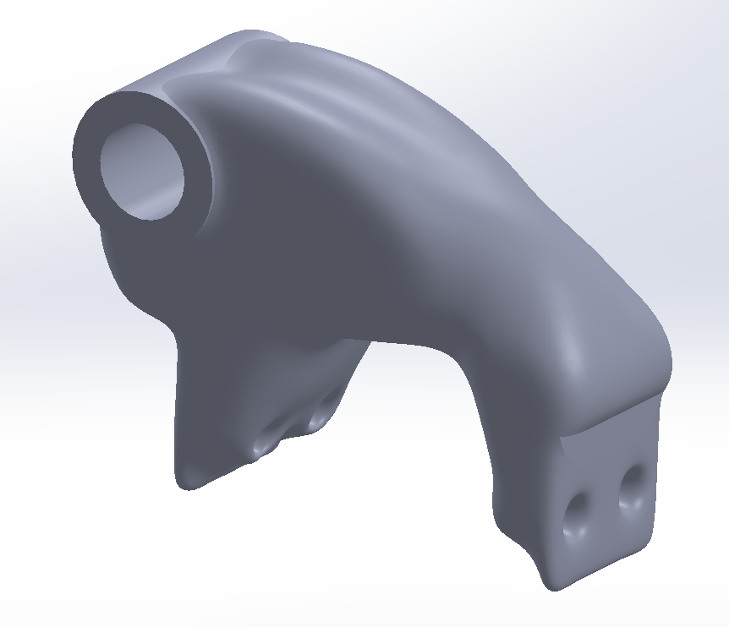
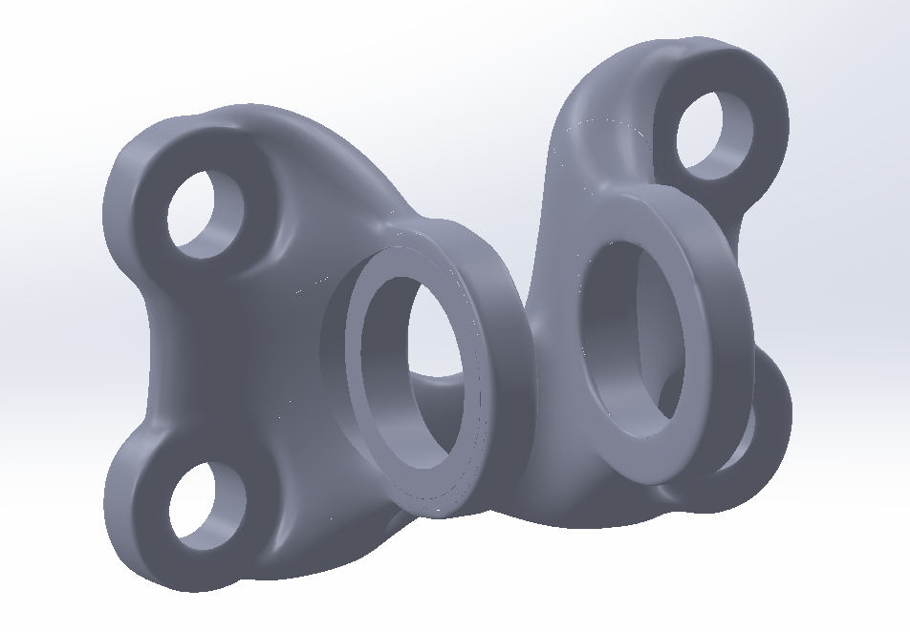
Engineering Calculations- Riley
Initial Topology Optimizations in nTop
Criteria:
Applied BCs used in FEA
Volume Constraint: 0.4
Symmetry Constraint
Figure 14: Topology Optimized Hip Side Bracket
Figure 15: Topology Optimized Motor Side Bracket
Riley, 12
Notes:
Update your engineering calculations, analysis tools, etc. Show them, their results, and how they informed your design. Also show part specifications and other quantifiable metrics used to determine selection (for example: you may pick a motor based on power, torque, RPM, etc) • Identify ERs and CRs still yet to be quantified and how you plan to prove that your design will work mathematically before “taking it off of the page”

Slide 14
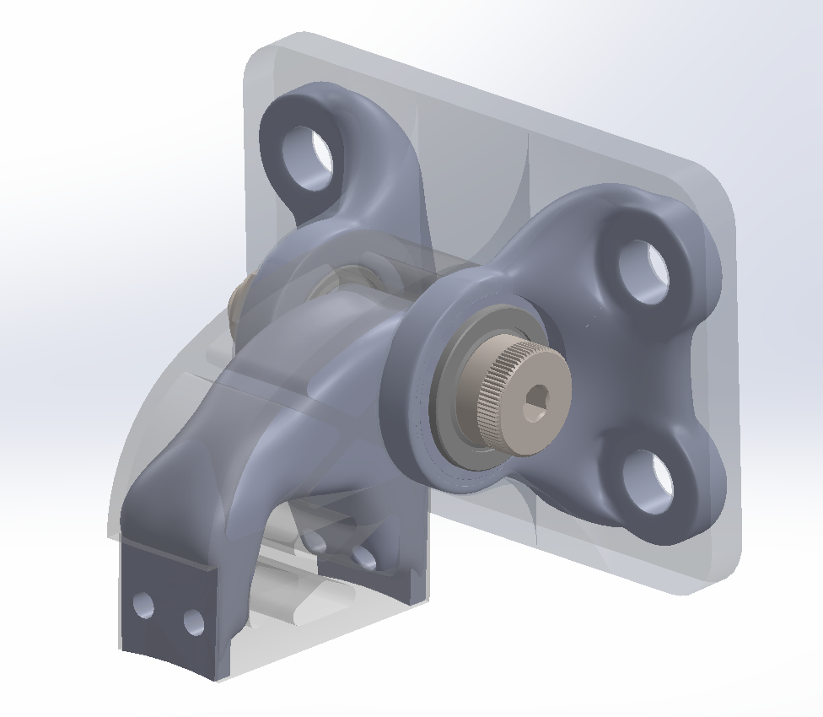
Engineering Calculations- Riley
Original Design vs. Topology Optimized Design
Results:
Material | Original Parts Mass (g) | Optimized Parts Mass (g)
AL 7075-T6 | 50 | 40
316SS | 140 | 100
Figure 16: Bracket Subassembly Comparison
Table 4: Materials and Mass Comparison
Riley, 13
Notes:
Update your engineering calculations, analysis tools, etc. Show them, their results, and how they informed your design. Also show part specifications and other quantifiable metrics used to determine selection (for example: you may pick a motor based on power, torque, RPM, etc) • Identify ERs and CRs still yet to be quantified and how you plan to prove that your design will work mathematically before “taking it off of the page”

Slide 15
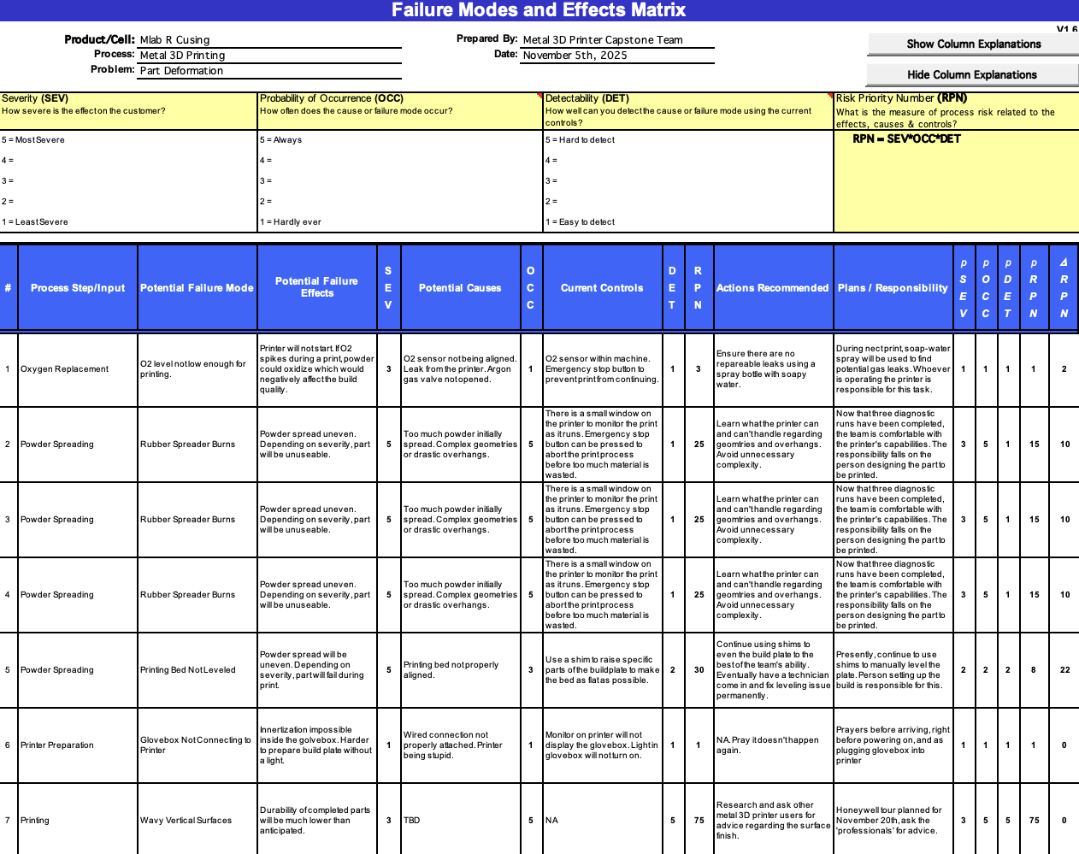
Design Validation
Table 5: Printer FMEA
Erik, 14
Notes:
Discuss your team’s FMEA, including critical potential failures and how your design mitigated these potential failures. Discuss the risk trade-off analysis that your team has performed. • Provide an overview of the Testing Procedures that you will complete in the second semester to prove the ERs have been met. • List all equipment, resources, space, etc. needed to complete the Testing Procedures

Slide 16
Design Validation- Erik
Proposed Testing Procedures:
Fit: Replace initial part with optimized one in completed assembly
Weight: Measure final weight of optimized part and compare to initial
Load: After fitting into assembly, test excavator with different bucket loads
Range: Measure length of final optimized part and compare to initial
Maximum Load:
Optimized stick into assembly with rotating insert attached
Load the stick with vertical bending force
Apply strain gauge to the top (flat) surface of the optimized stick
Compare strain results with those collected from FEA
Erik, 15
Notes:
Discuss your team’s FMEA, including critical potential failures and how your design mitigated these potential failures. Discuss the risk trade-off analysis that your team has performed. • Provide an overview of the Testing Procedures that you will complete in the second semester to prove the ERs have been met. • List all equipment, resources, space, etc. needed to complete the Testing Procedures

Slide 17
Design Validation- Sichao
Potential failures such as fatigue cracking and deformation under repeated loading were considered during the validation process.
Finite Element Analysis (FEA) was performed under axial and bending loads to validate the strength and stiffness of the topology-optimized design.
Results show that maximum stress and displacement remain within safe limits, confirming high structural performance.
Simulated strain data from FEA will be compared with experimental strain gauge measurements to verify accuracy.
Fatigue life analysis will be conducted in SolidWorks/ANSYS to evaluate durability under cyclic loading, ensuring a lifetime of at least 25,000 cycles.
Ensures the component is lightweight, strong, and structurally stable, suitable for its intended application.
Sichao, 16
Notes:
Discuss your team’s FMEA, including critical potential failures and how your design mitigated these potential failures. Discuss the risk trade-off analysis that your team has performed. • Provide an overview of the Testing Procedures that you will complete in the second semester to prove the ERs have been met. • List all equipment, resources, space, etc. needed to complete the Testing Procedures

Slide 18
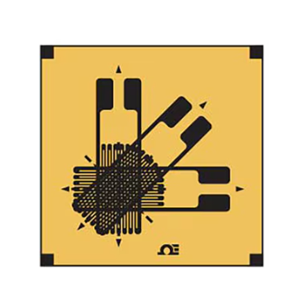
Design Validation- Riley
Potential Strain Gauge:
SGD-2/350-RY53
Small 3-Element Rectangular Stacked Rosette
Proposed Testing Procedure
Weight: Measure final mass of printed part and compare with existing components
Lifetime: Complete fatigue FEA using ANSYS/SolidWorks to evaluate the lifetime of the topology optimized part
Manufacturing Costs: Account for material costs (powder & gas) and compare with costs of existing components
Bending Moment:
Design and assemble a test bench using the bracket and leg subassemblies
Apply motor torques with strain gauge fixed to the top surface of the Motor Side Bracket
Compare strain results with those collected from FEA
Axial Force:
Design and assemble fixture for the Hip Side Bracket with shoulder bolt inserted
Load the shaft in multiple directions (vertically and horizontally)
Apply strain gauge to a surface of the Hip Side Bracket
Compare strain results with those collected from FEA
Figure 17: Potential Strain Gauge
Riley, 17
Notes:
Discuss your team’s FMEA, including critical potential failures and how your design mitigated these potential failures. Discuss the risk trade-off analysis that your team has performed. • Provide an overview of the Testing Procedures that you will complete in the second semester to prove the ERs have been met. • List all equipment, resources, space, etc. needed to complete the Testing Procedures

Slide 19
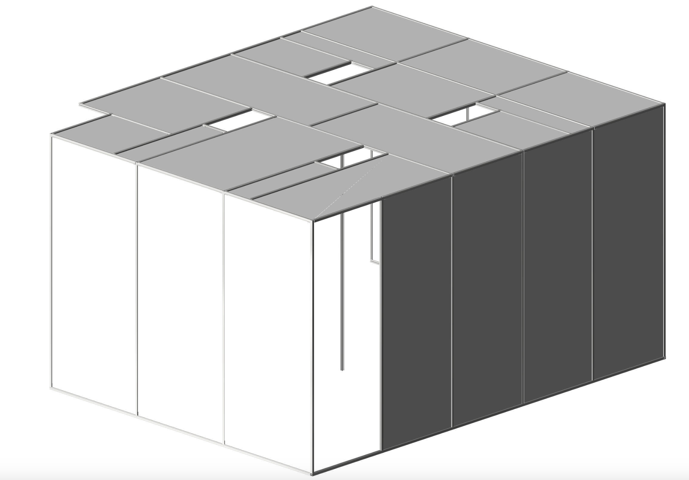
Commissioning Update
Specific dimensions for IdeaLab wall
126/142x170x92"
Support beam in center
Slots in roof for fan-filters
Figure 18: Final Partition Design
Erik, 18

Slide 20
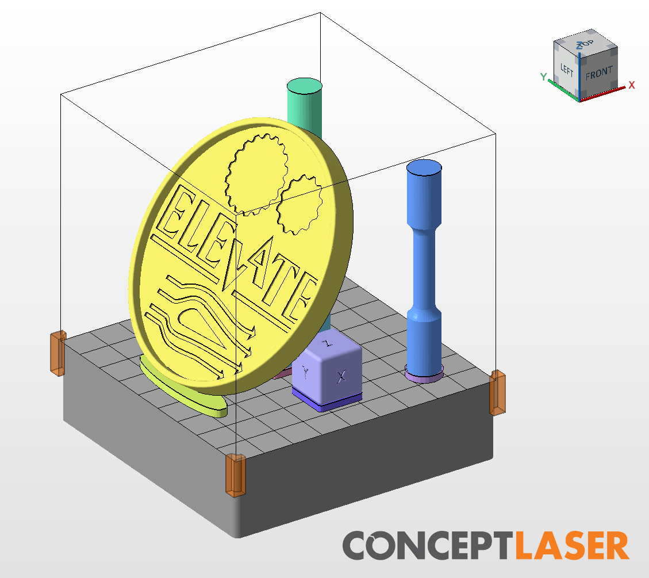
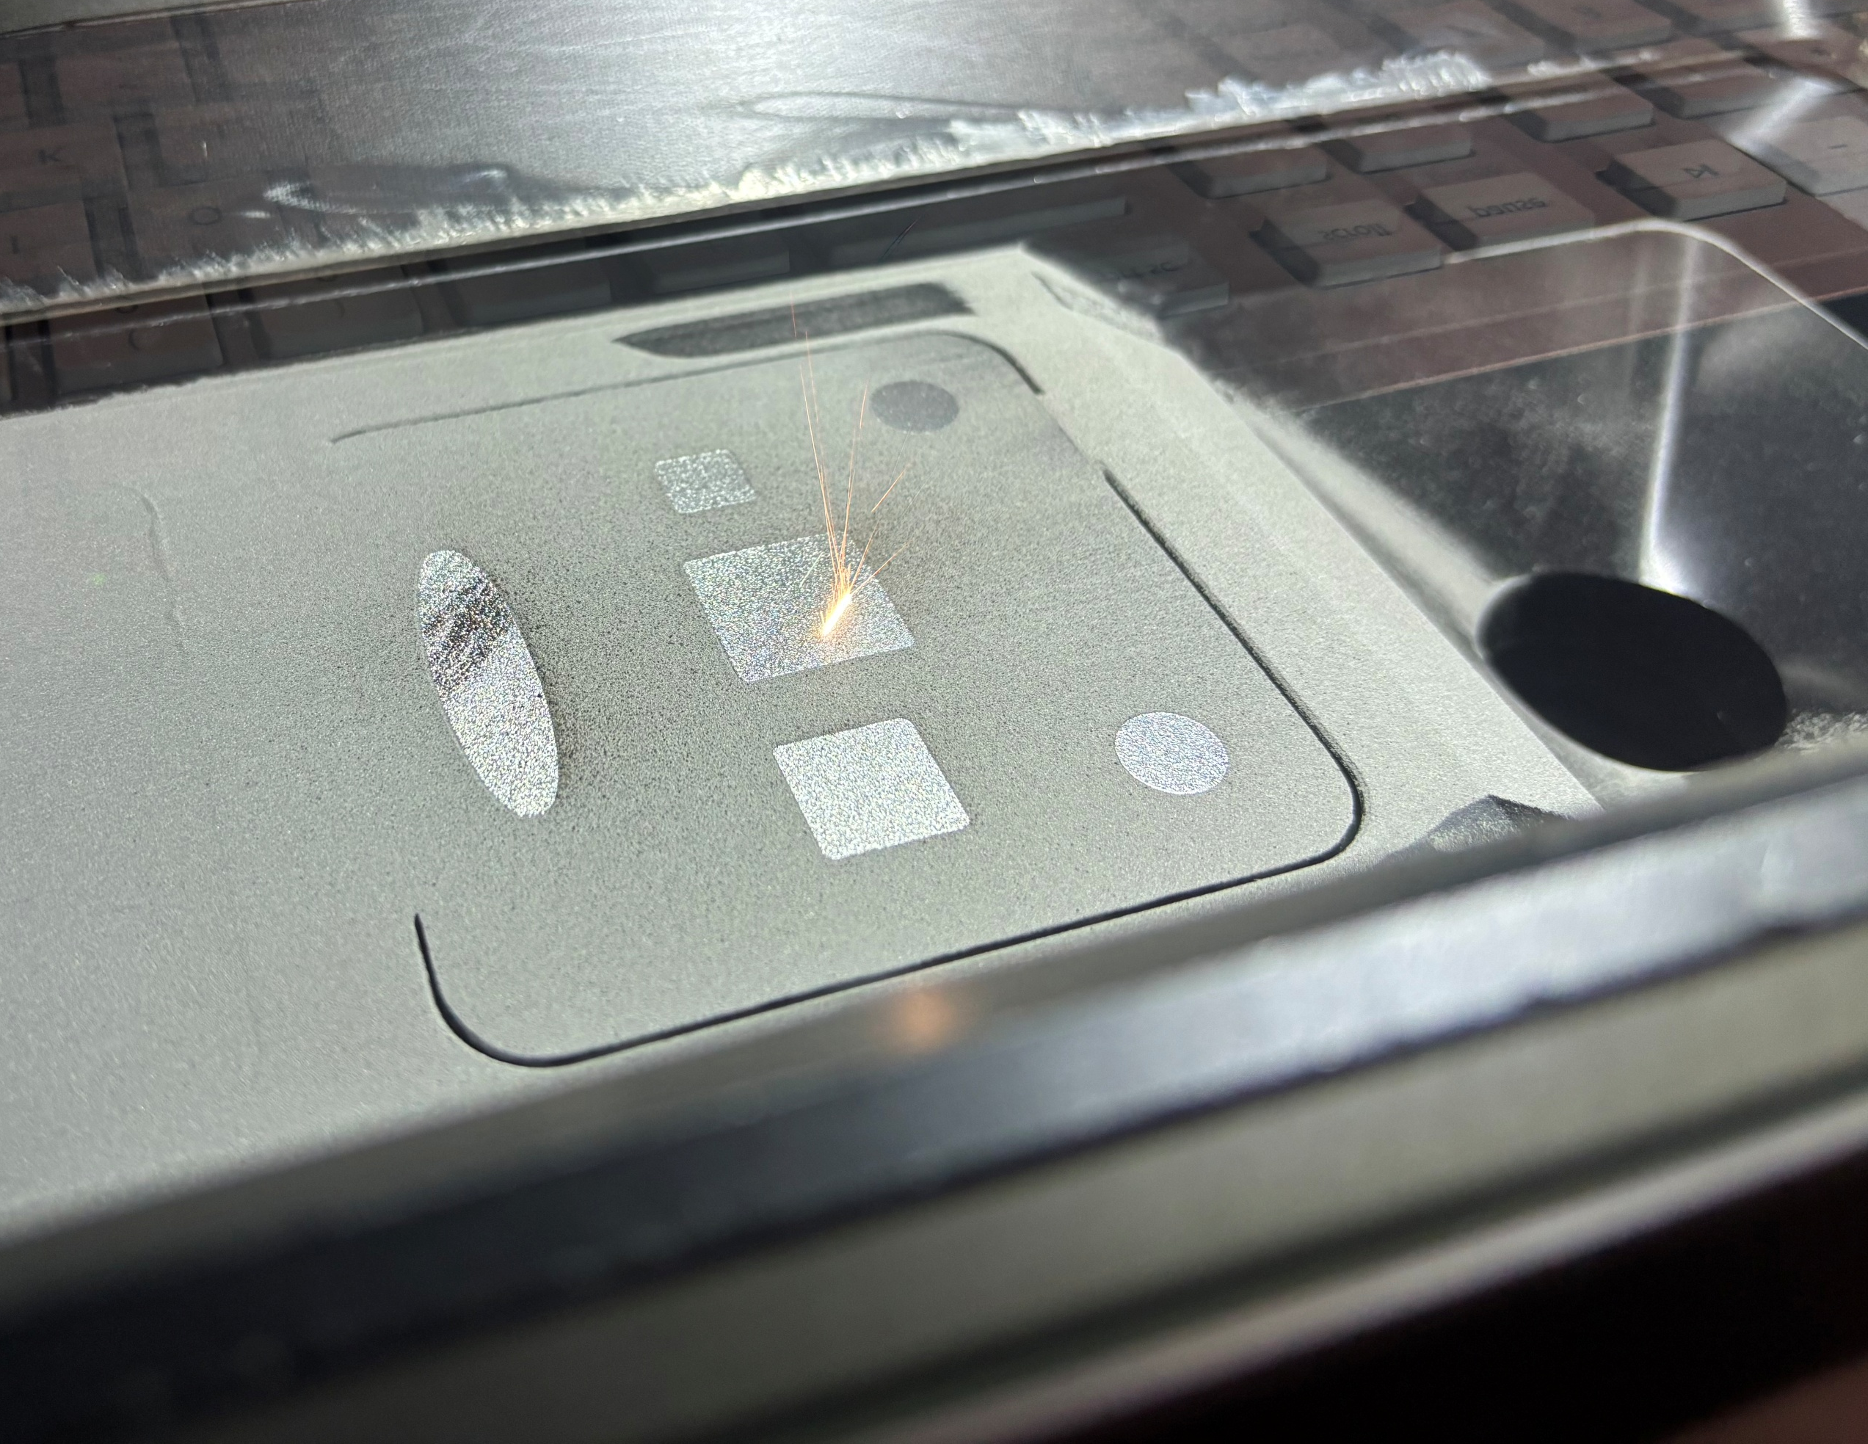
Commissioning Update
Print Update:
Goal- evaluate if low print quality is consistent
Printed additional parts
Calibration cubes
10mm
15mm
20mm
Test specimens
Elevate Event Coaster
Figure 20: Start of Print Process
Figure 19: Print 3 Build Plate
Riley, 19

Slide 21
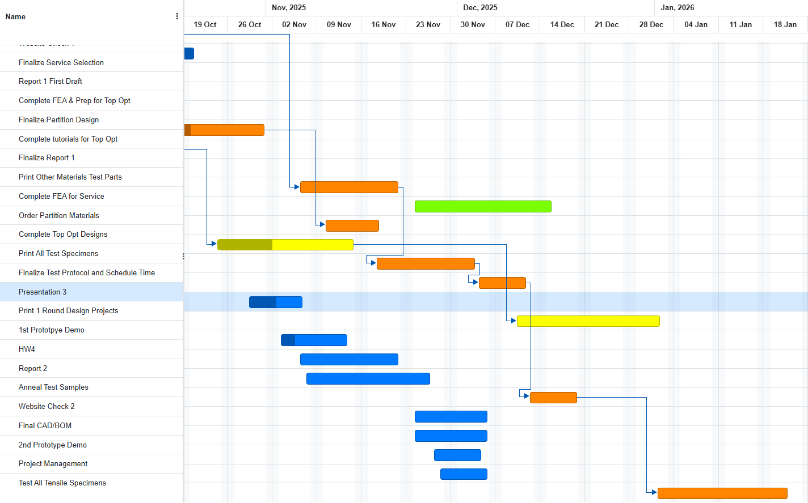
Schedule- GANT Chart
Figure 21: GANTT Chart
Riley, 20

Slide 22
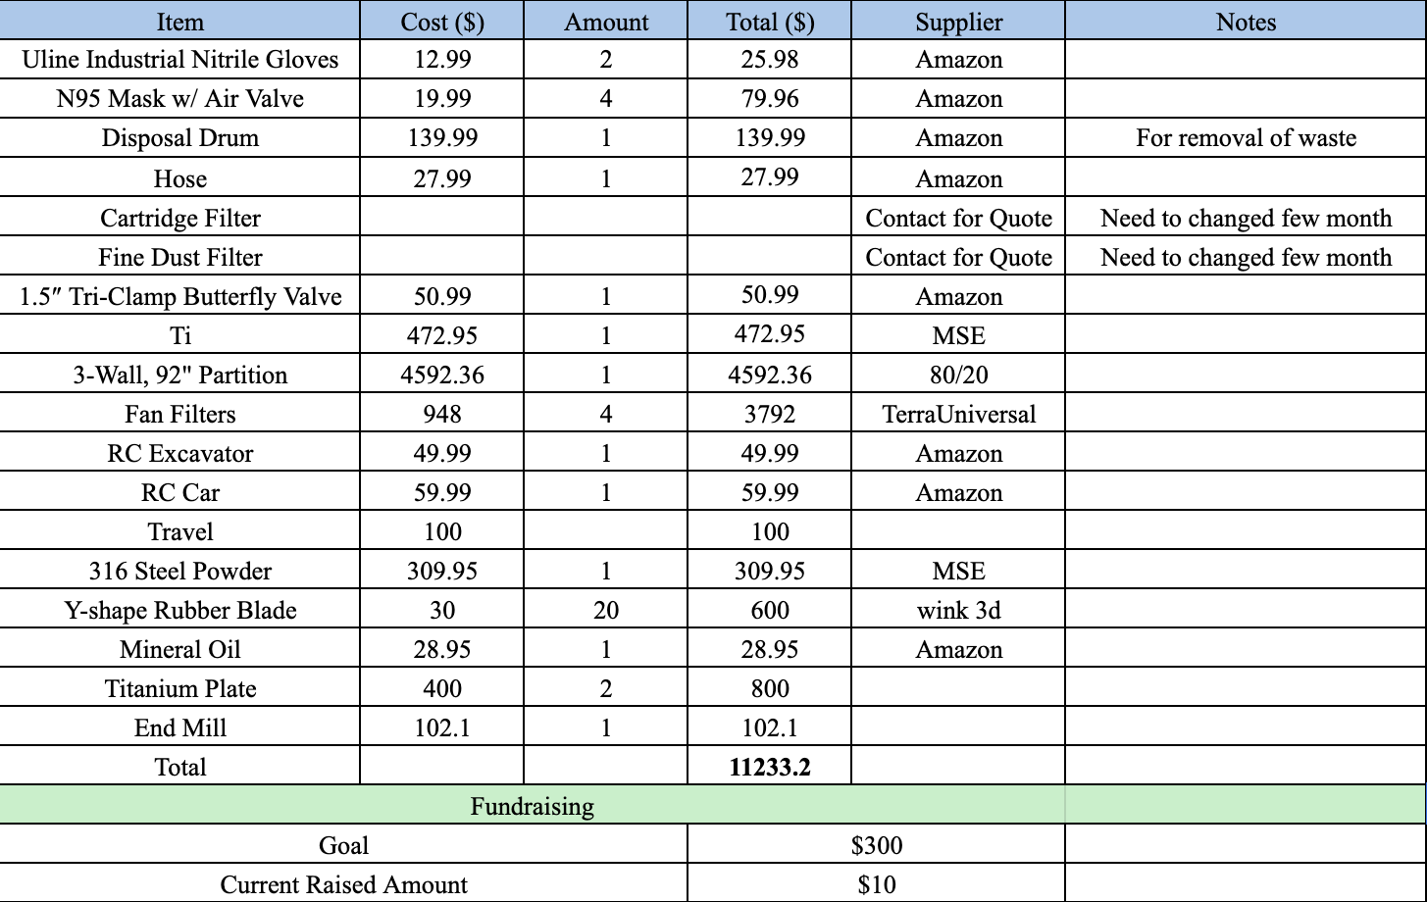

Budget and BOM
Table 5: Materials Order List
Figure 22: GoFundMe QR Code
Sichao, 21

Slide 23
Thank you And Any Questions?

